Slide 1
NBA Player Analysis
Group 2 David Smith
Ronaldo Sevilla
Daniel Carvajal

Slide 2

Introduction
As the Miami Heat looks to sign a new center, our group is playing the role of determining which player would be the best option
Centers are valued for their height and ability to protect their own basket from scoring attempts on defense, while scoring and rebounding with high efficiency on offense

Slide 3
Data Overview
Source of data: Basketball-Reference.com, 2022-23 NBA Player Stats
Column descriptions:

Slide 4
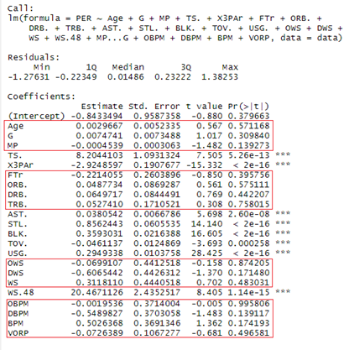
Data Exploration – Linear Regression Model
Player Efficiency Rating correlates to:
True Shooting Percentage
Three Point Attempt Rate
Assist Percentage
Steals
Blocks
Turnovers
Usage Percentage
Win Shares per 48 Mins

Slide 5
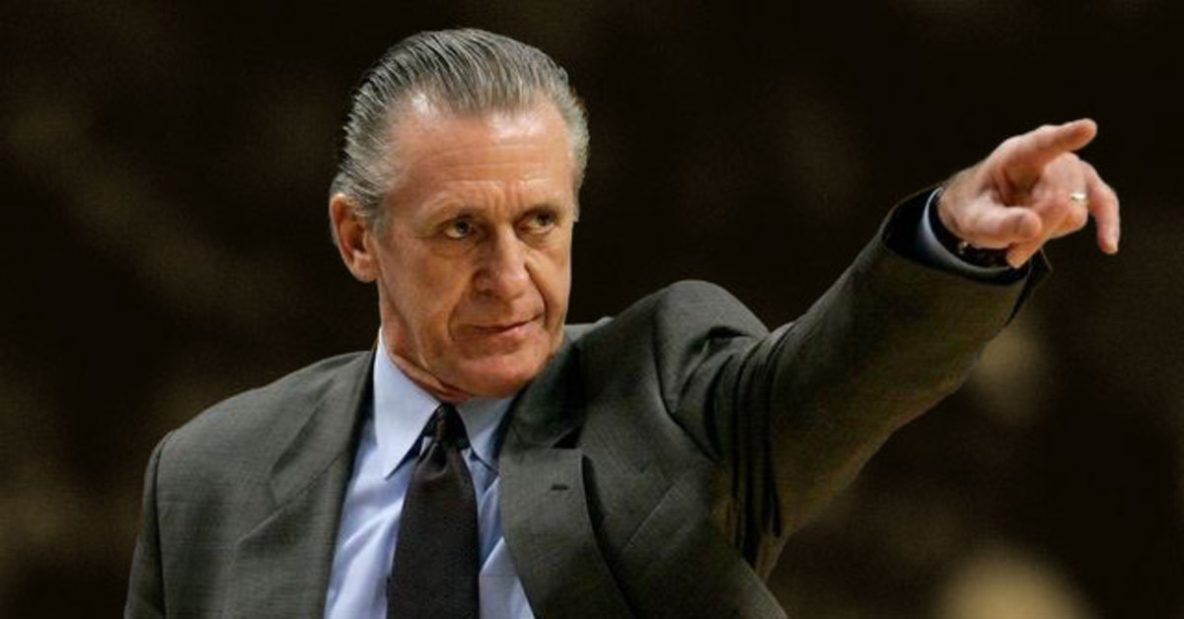
Constraints – Executive Decisions
No one over $21 Million!
42 game threshold!
20-minute average per game!
Top players by PER!
Effective offensive player preferred!
Pat Riley, Miami Heat Team President

